Slide 1
Task-3
Title: Cross Site Scripting
Domain: Vulnweb.com
Subdomain: testasp.vulnweb.com

Slide 2
Steps to reproduce:
Step 1: Visit http://testasp.vulnweb.com/
Step 2: On the top menu you will find a search option.
Step 3: Click on it and you will be prompted with the Search box.
Step 4: You can intercept the request in Burp Suite
Step 5: Now you can find different payloads for XSS.
Step 6: Send the request to the intruder and paste all the payloads.
Step 7: Try to find a successful payload for XSS.
Step 8: Prepare a report for it.

Slide 3
Impact:
Cross site scripting can allow any attacker to masquerade as a victim user to carry out any actions that the user is able to perform. The attacker will be able to access any of the user's data. If the victim user has privileged access within his/her data, then the attacker might be able to gain full control over all of the data. The attacker can read your user’s data. And hence, it can lead to stealing of your user data and it can be harmful for your website/company.

Slide 4
Mitigation:
If you want to prevent your website to be vulnerable of cross site scripting then you have to just enable noscript on browser. You can also use Content Security Policy (CSP) to reduce the severity of the cross site scripting vulneribilities. Content Security Policy (CSP) aims to mitigate the impact of cross site scripting and will prevent the exploitation of the vulneribility.

Slide 5
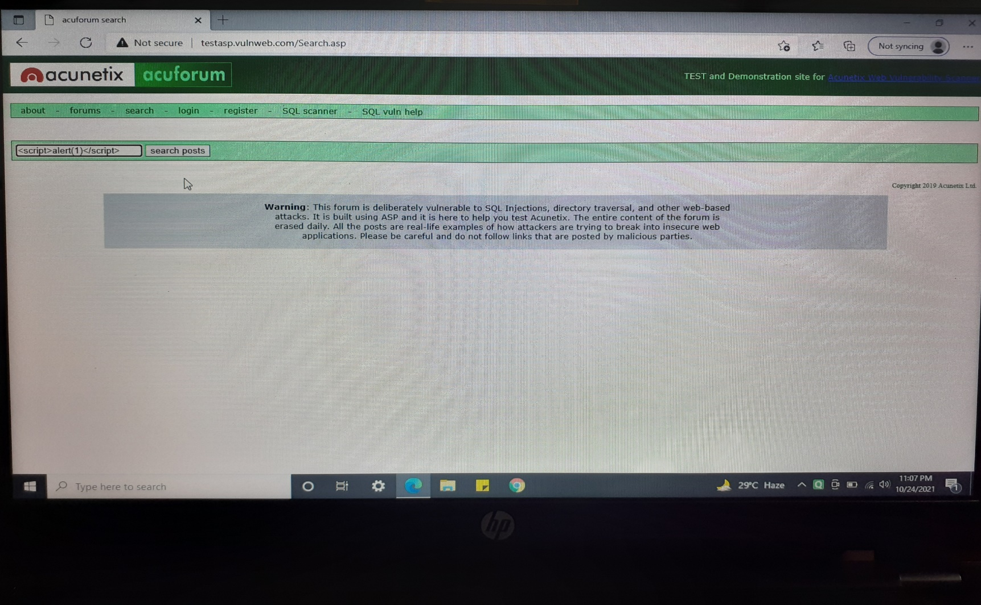
Screenshots are included in the Report which is attached below:

Slide 6
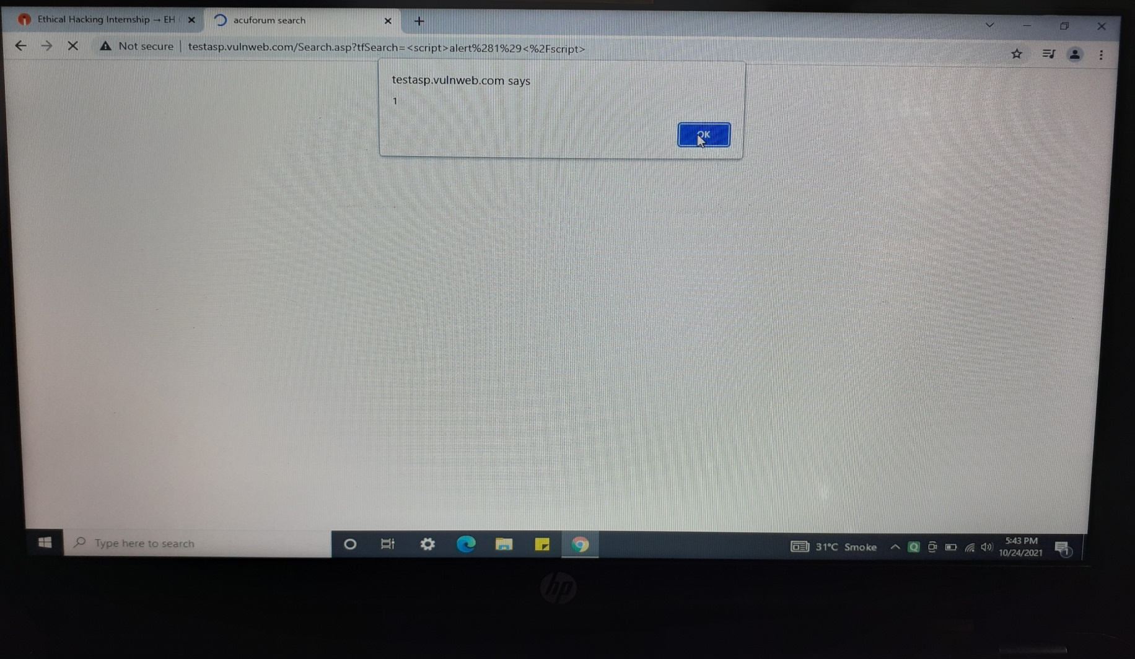

Slide 7
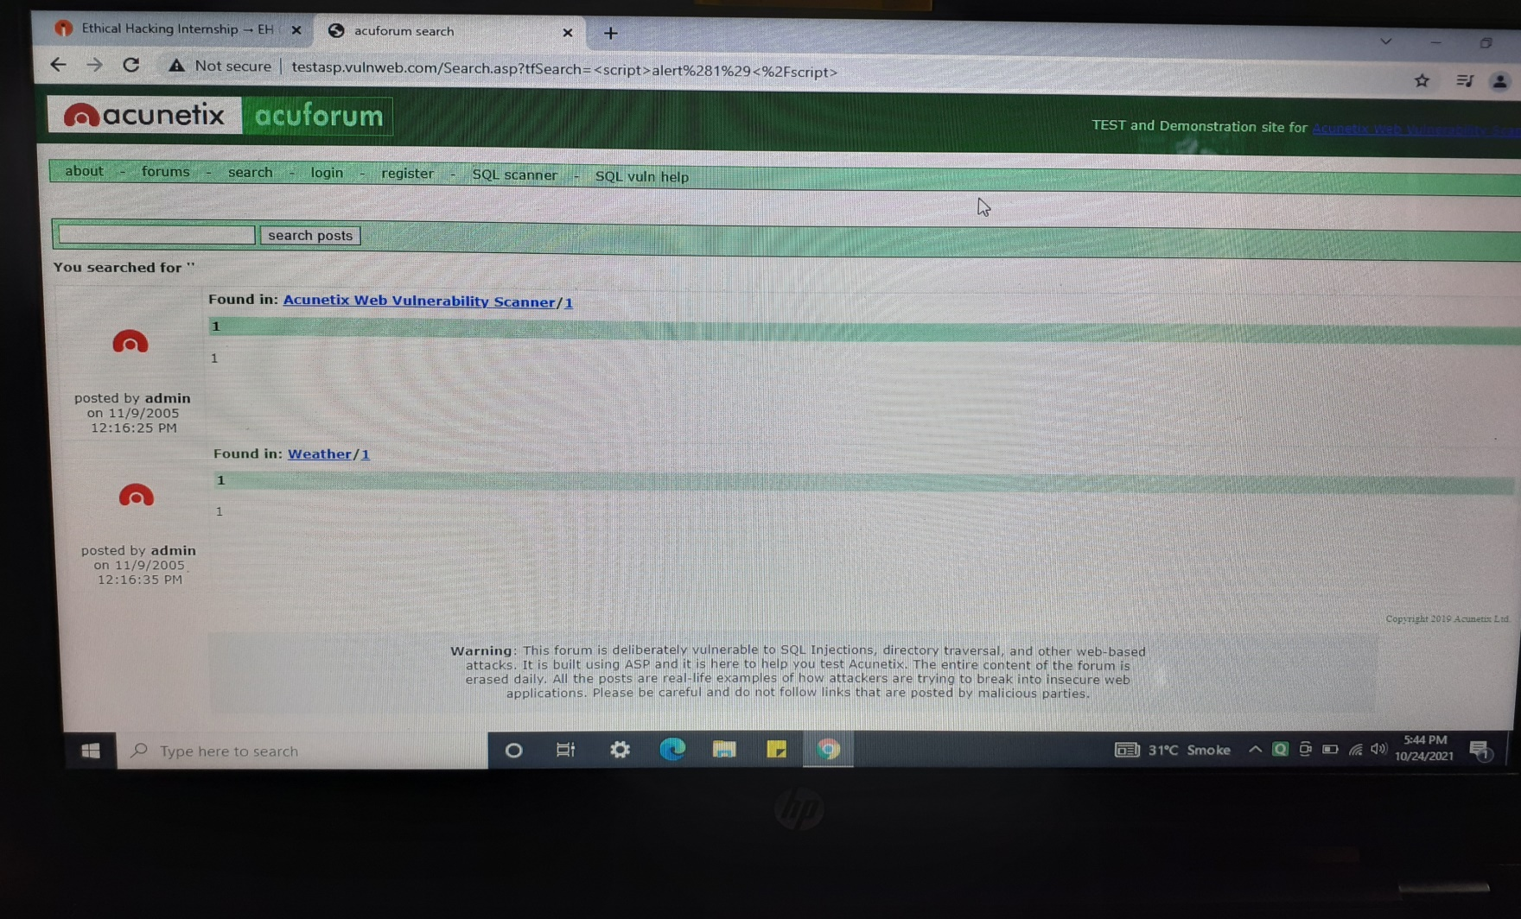

Slide 8
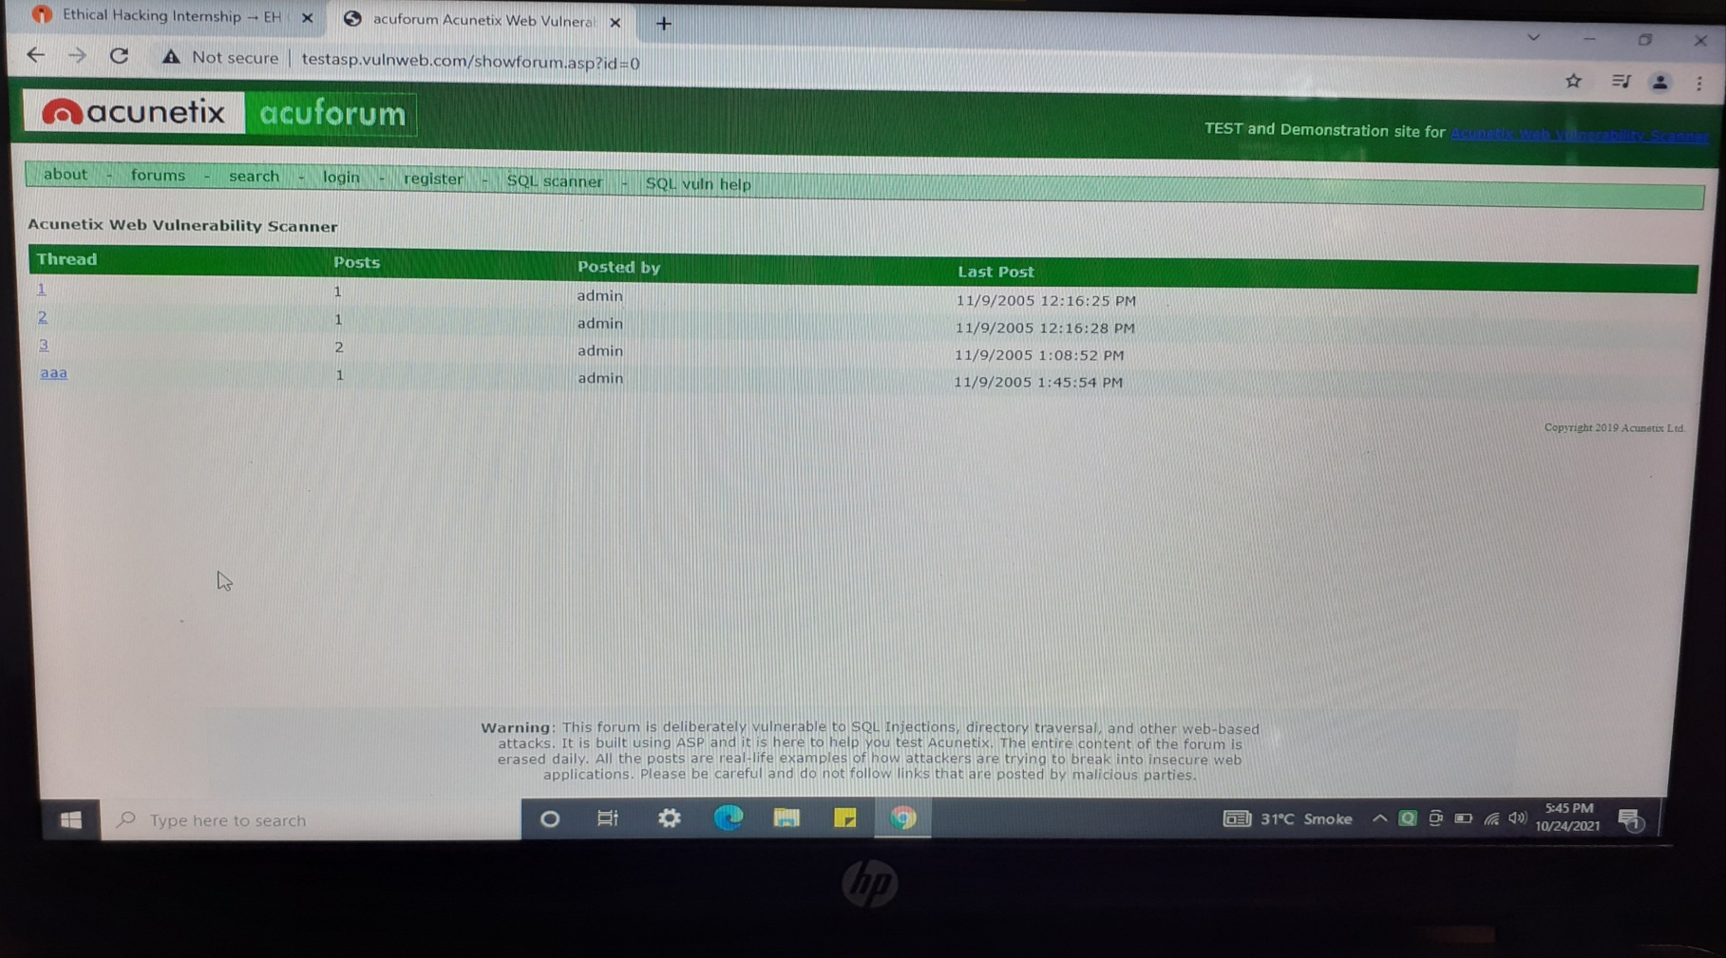

Slide 9
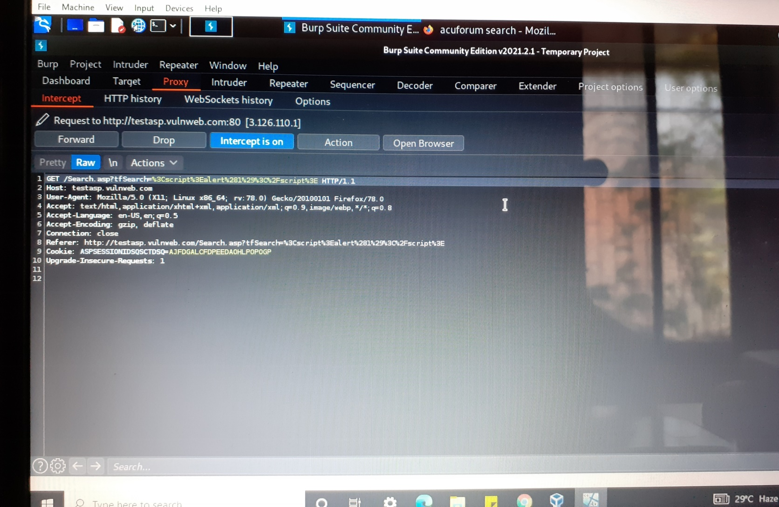

Slide 10
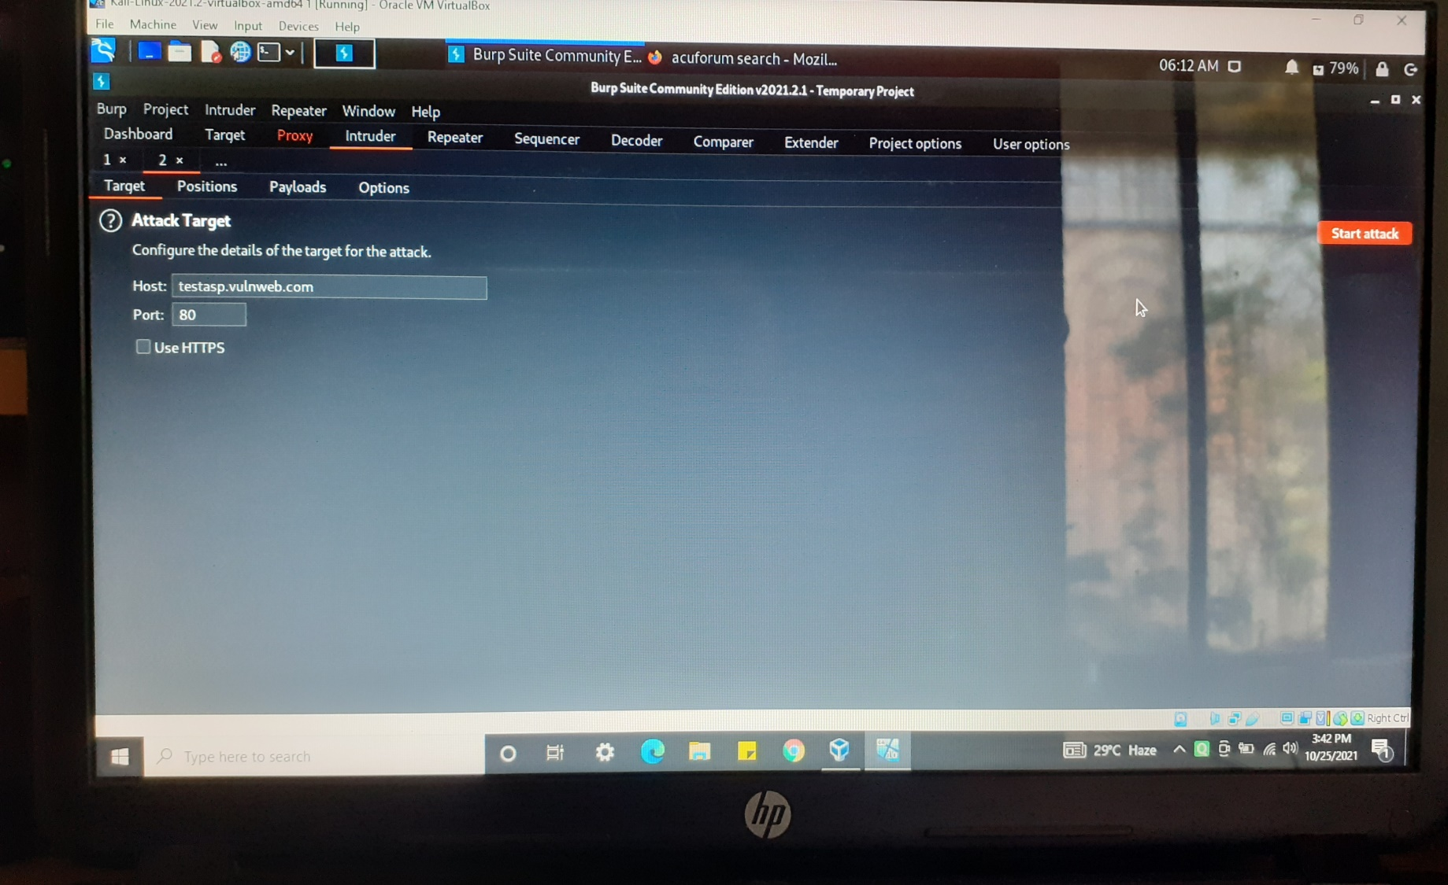

Slide 11
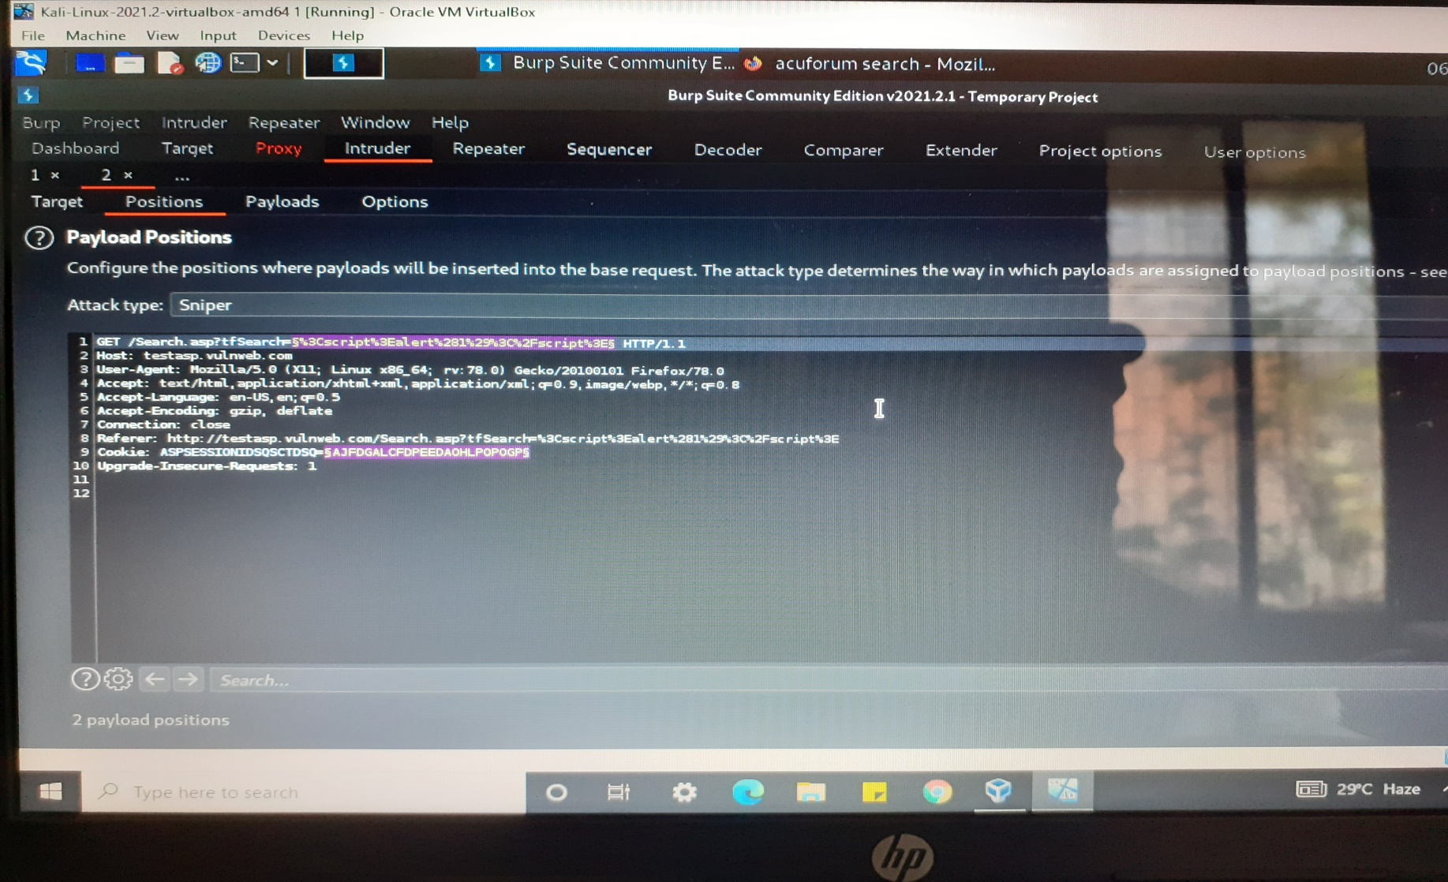

Slide 12
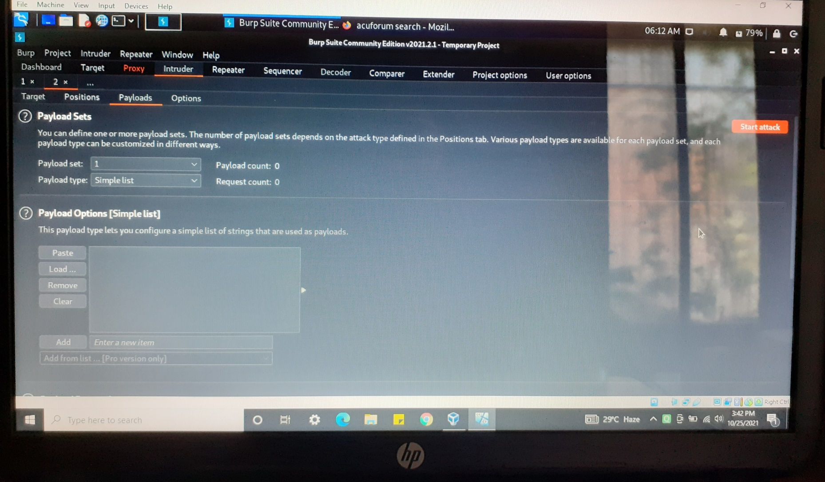

Slide 13
